Slide 1
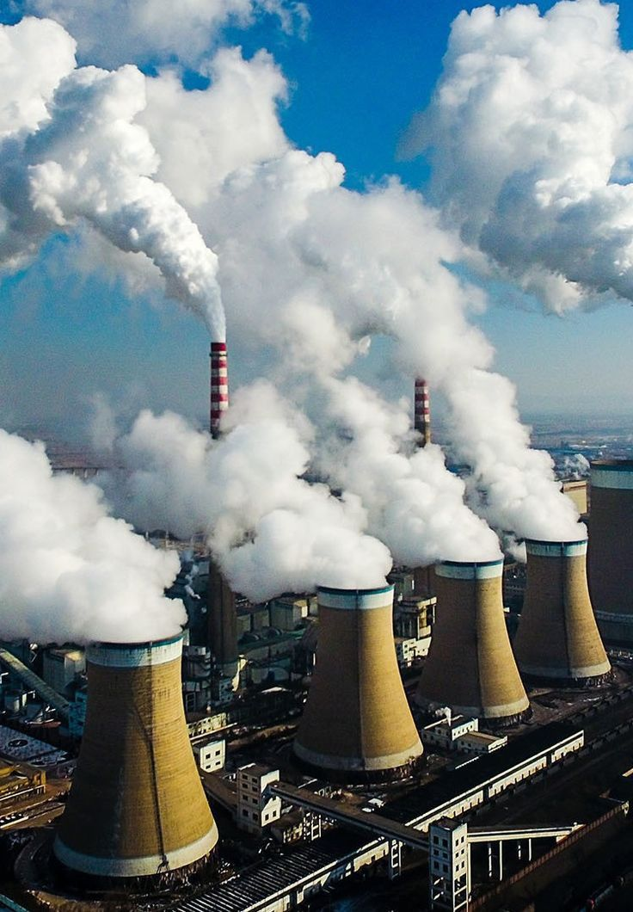
Predicting Sources Of Urban Air Pollution Using Deep Learning
Project review 2

Slide 2
By:
23BCE7484 Kushal Veerapaneni
23BCE7200 Sayyed Nazeer Hasan
23BCE8172 Kakarlamudi Venkata Dhanush
23BCE7768 Vinayak Narendra Biswal
Submitted to:
Dr. K. G. Suma,
Associate Professor, SCOPE, VIT – AP University.

Slide 3
Abstract
Built a CNN-LSTM deep learning model to identify urban pollution sources.
Classified air pollution into four categories: vehicle, industrial, fire smoke, and dust.
Used Beijing Multi-Site Air Quality dataset (PM2.5, PM10, SO2, NO2, CO, O3 + weather data).
Captured spatial and temporal patterns for accurate source detection.
Applied weakly supervised labeling using pollutant ratios, weather, and time trends.
Ensured explainability with SHAP, validating model predictions.
Designed as a scalable, real-time tool for pollution monitoring.
Supports policy-making and public health improvements by identifying major sources.

Slide 4
Aim Of The Project
To develop a deep learning-based system that accurately identifies and classifies sources of urban air pollution using spatial-temporal data, enabling real-time monitoring, policy support, and public health protection.

Slide 5
Objective
Classify urban air pollution into vehicle, industrial, fire smoke, and dust sources.
Use CNN-LSTM architecture to capture spatial and temporal pollution patterns.
Apply weakly supervised labeling for training with limited ground truth.
Ensure model interpretability using SHAP for trustworthy predictions.
Provide a real-time, scalable tool to support environmental policy and public health.

Slide 6
Scope of the Work
Focused on urban environments with high pollution variability.
Uses Beijing Multi-Site Air Quality dataset (2013–2017) for training and validation.
Limited to four major pollution sources: vehicle, industrial, fire smoke, and dust.
Designed for real-time monitoring and source attribution.
Scalable to other cities and datasets with similar pollution indicators.
Provides decision support for policymakers, researchers, and environmental agencies.

Slide 7
Motivation Of The Work
Air pollution is a global crisis : WHO reports 99% of people breathe unsafe air.
Causes millions of premature deaths due to respiratory and cardiovascular diseases.
Traditional source identification methods (CMB, PMF) are costly, data-heavy, and less effective.
Need for fast, accurate, and low-cost solutions to track pollution sources.
Deep learning offers powerful tools to capture complex spatial-temporal patterns in air quality data.
Helps policymakers and communities take targeted actions to improve air quality and public health.

Slide 8
Literature Survey
Supervised Machine Learning Approaches for Predicting Key Pollutants and for the Sustainable Enhancement of Urban Air Quality: A Systematic Review
Deep Learning based multimodal urban air quality prediction and traffic analysis
Meteorological and traffic effects on air pollutants using Bayesian networks and deep learning
Investigating major sources of air pollution and improving spatiotemporal forecast accuracy using machine learning and a proxy
Deep Leaning for Prediction of the Air Quality Response to Emission Changes
Developing AI-Based Pollution Source Identification Models: A Deep Learning Approach Using Satellite Data in Industrial Regions
Source apportionment of PM₁₀ particles in the urban atmosphere using PMF and LPO-XGBoost
A literature Review on the Prediction of Air Quality Index and Forecasting Ambient Air Pollutants using Machine Learning Algorithms
Transfer Learning-Driven Hourly PM_{2.5} Prediction Based on a Modified Hybrid Deep Learning
A Deep CNN-LSTM Model for Particulate Matter (PM_{2.5} ) Forecasting in Smart Cities

Slide 9
Literature Review(Continuation)
11. Deep Learning-based Smart Street Lamps – A Solution to Urban Pollution
12. Urban PM_{2.5} Concentration via Attention Based CNN-LSTM
13. HighAir: A Hierarchical Graph Neural Network-Based Air Quality Forecasting Method
14. A forecasting system for deterministic and uncertain prediction of air pollution data
15. Prediction of air pollutants on roadside of the elevated roads with combination od pollutants periodicity and deep learning method
16. Machine Learning model to predict vehicle electrification impacts in urban air quality and related human health effects

Slide 10
Journals
Accurate Hourly AQI Prediction using CNN-LSTM-MHA+GRU (2024), journal link .
Meteorological and Traffic Effects on Air Pollutants using Bayesian Networks and Deep Learning (Published 2025), journal link
Improving Air Quality Forecasting: A New Spatio-Temporal Model Using Graph Convolution and Multi-Head Attention (Published 2024), journal link
Mitigating Air Pollution Risks with Deep Learning: A Quantum-Optimized Approach for Nitrogen Dioxide Prediction in Los Angeles (Published 2025), journal link
Comparative Analysis of Deep Learning and Machine Learning Models for Air Quality Classification (Published 2025), journal link

Slide 11
Proposal Work

Slide 12
Hardware Requirements
GPU: NVIDIA GPU with CUDA support (e.g., RTX 3080/4080, 16 GB VRAM)
Cloud GPUs: Kaggle, Google Colab for large-scale training
RAM: Minimum 4 GB (8 GB recommended)
Storage: 1–2 GB SSD (cloud/local) for datasets and model storage

Slide 13
Software Requirements
Operating System: Ubuntu/Linux (preferred), Windows/macOS (extra setup needed)
Programming Language: Python 3.8+
Deep Learning Frameworks: TensorFlow (Keras) / PyTorch
Data Processing Tools: NumPy, Pandas, Scikit-learn
Visualization Tools: Matplotlib, Seaborn
Model Explainability: SHAP library
Time Series Tools: tsai, sktime
Version Control & Dev: Git, Jupyter Notebook
Cloud Platforms: AWS, Google Cloud, Google Colab

Slide 14
Conclusion
Developed a CNN-LSTM model to identify urban air pollution sources with high accuracy.
Combined air quality and weather data for robust spatial-temporal analysis.
Overcame limitations of traditional methods (costly, linear, data-heavy).
Ensured transparency and trust through SHAP-based explainability.
Provides a real-time, scalable tool for policymakers and environmental agencies.
Supports targeted interventions to improve public health and environmental sustainability.
Future work: explore unsupervised methods, satellite data integration, and Transformer-based models for better source detection.

Slide 15
References
Google Scholar. (2025). Scholarly research on air pollution and deep learning. Retrieved from https://scholar.google.com
IEEE Xplore. (2025). Digital library for research in engineering and technology. Retrieved from https://ieeexplore.ieee.org
ScienceDirect. (2025). Scientific articles on air pollution and deep learning. Retrieved from https://www.sciencedirect.com
TheASPD (2025). International Journal of Environmental Sciences (IJES). Retrieved from https://theaspd.com

